Slide 1

Insta Care
The existing problems and possible solutions to them.

Slide 2
02
Overview of Problem

Slide 3
Problem Statement
Small clinics grapple with challenges hindering efficient appointment management and revenue growth. These include:
Inefficient Scheduling: Manual processes often result in errors and conflicts in appointment calendars, leading to frustration and inefficiency.
High No-Show Rates: No-shows and last-minute cancellations waste valuable time and resources, impacting revenue and patient care quality.
Limited Online Presence: Without a robust digital presence, clinics struggle to attract new patients and compete with larger healthcare providers, missing out on growth opportunities.

Slide 4
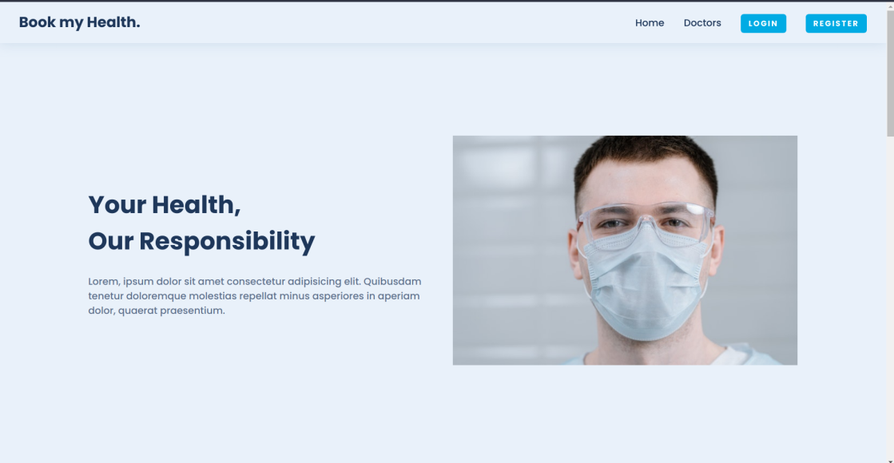
Why do we need to improve patient appointment scheduling?
In today's evolving healthcare landscape, India requires a centralized platform with an appointment booking application to streamline healthcare processes effectively. This platform should offer users the convenience of browsing doctors, managing profiles, and booking appointments seamlessly. Aspiring doctors should have a path to apply, and administrative operations need to ensure smooth functioning.
Ultimately, addressing the challenges and opportunities in the healthcare sector post-COVID is a critical concern.

Slide 5
Solution
To create an efficient centralized platform for improving patient appointment scheduling, follow these steps:
Platform Development:
Develop a user-friendly web app where hospitals, doctors, and patients can register.
User Registration and Dashboard:
Users, hospitals, and doctors can sign up, gaining access to customized appointment and preference management dashboards.
Doctor's Dashboard:
Created a distinct key system for doctors to access their dashboards, allowing them to control availability, appointments, and profiles.
User Filtering Options:
Enable patients to search and filter doctors using criteria like specialization, location, availability, and Ratings.
Notification System:
Enabling appointment confirmations, reminders via email/SMS, and a notification system for appointment updates and new bookings.
Appointment Swaps:
Enable patients in the same healthcare network to swap appointments, reducing cancellations and rescheduling.
Data Security:
Implement strong data security for HIPAA-compliant safeguarding of patient information.
Marketing and Adoption:
Promote widespread use, consider partnering with healthcare organizations to increase visibility.

Slide 6
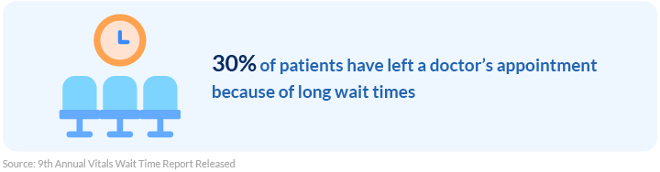
BUSINESS MODEL
Subscription-Based Revenue: Generate income through subscription plans for healthcare providers, offering premium features and priority scheduling.
Advertising and Partnership: Collaborate with healthcare-related businesses for advertising opportunities and strategic partnerships.
Data Insights for Profit: Leverage anonymized data insights for monetization while ensuring strict data privacy and security measures.

Slide 7
3 TYPES OF USERS
WEBSITE
ADMIN
PATIENT
DOCTOR

Slide 8
STACK USED
MONGO EXPRESS NODE REACT
we have implemented MongoDB as our primary database management system. MongoDB, a NoSQL database, offers a flexible and scalable solution that aligns seamlessly with the dynamic nature of healthcare data
With Express.js, we prioritize agility and efficiency, allowing us to rapidly prototype, develop, and deploy features essential to healthcare workflows. Its middleware architecture facilitates seamless integration with various components such as authentication, authorization, and data validation, ensuring compliance with regulatory standards and safeguarding sensitive patient information.
By harnessing the power of Node.js, we optimize the performance and efficiency of our backend services, enabling healthcare providers to access, analyze, and share patient data securely and efficiently. Whether it's managing electronic health records, coordinating care plans, or enabling telehealth consultations, Node.js serves as the backbone of our technology stack, driving innovation and excellence in healthcare delivery.
React's component-based architecture facilitates modular development, allowing us to create reusable UI elements that promote consistency and maintainability throughout our healthcare website. This modular approach streamlines development workflows, accelerates feature implementation, and fosters collaboration among multidisciplinary teams working on different aspects of the project.

Slide 9
Team Name:
The Rockets
Team Members
1. Aditi Rana
2. Abhishek Thakur
3. Akshat Chandel
4. Abhinn Singh Bisht

Slide 10
Thank you

